Slide 1
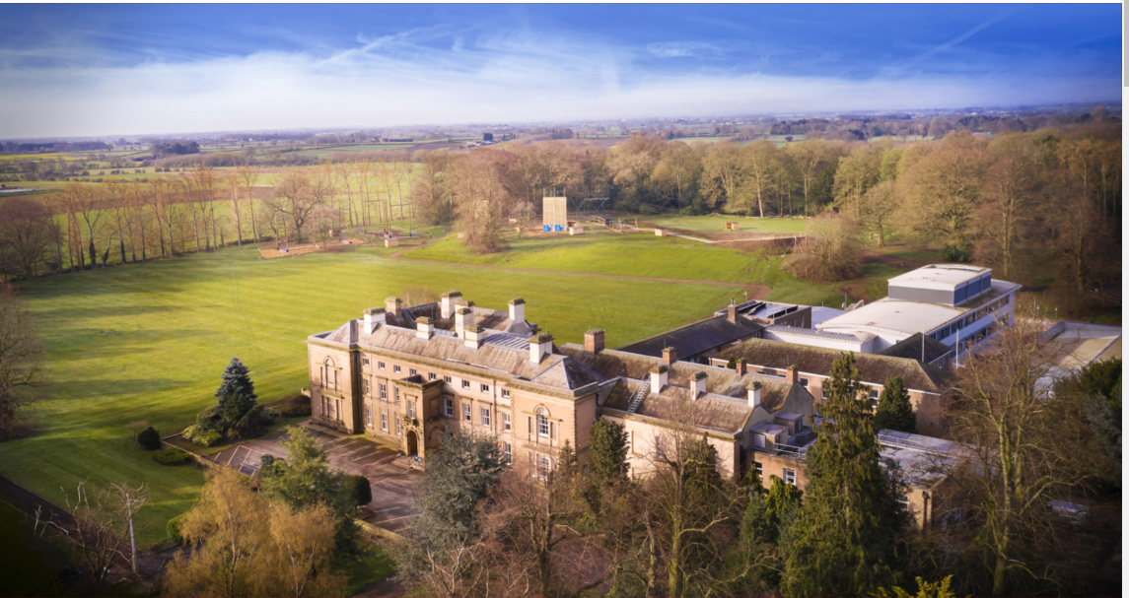
PGL Trip October 2026

Slide 2
Timings
Leaving school at 2:30pm on Friday 23rd October. Arrive at 2pm
Arrive back at school 7:00-7:30pm on Sunday 25th October – all children need collecting and will not be allowed to walk home.

Slide 3
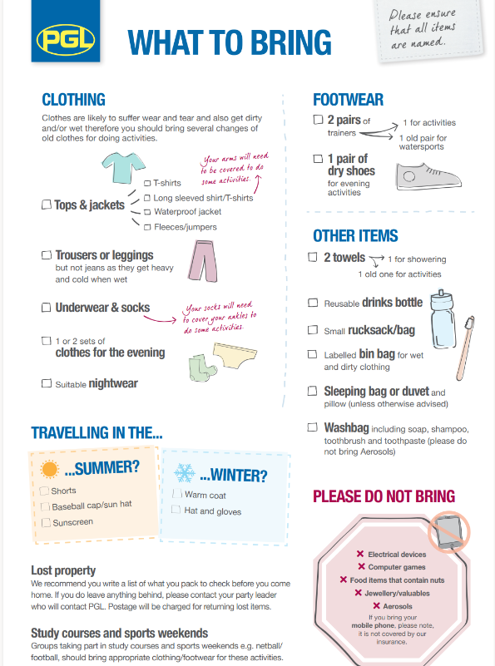
Kit list – things to note:
NO aerosols
NO electronics/phones/tablets
NO jewellery or valuables
I’d bring a binbag to put worn clothing straight into in your bag – so you don’t get everything confused.

Slide 4
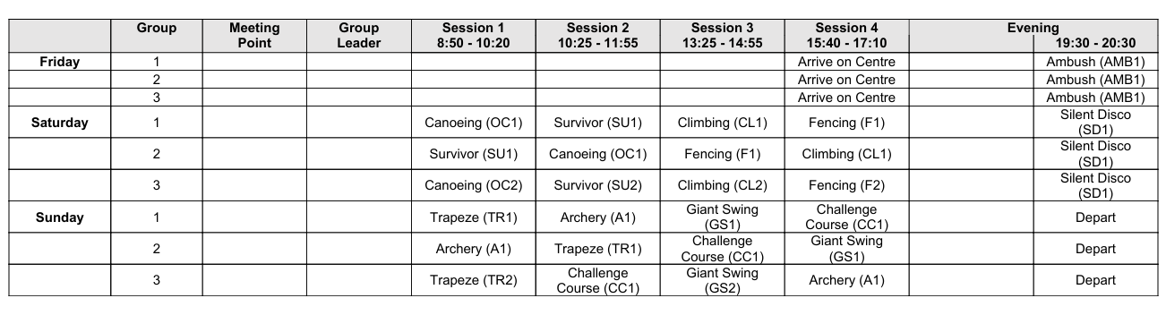
Provisional Timetable

Slide 5
Food
Newby Wisk – food menu (in google)
https://schoolsandgroups.pgl.co.uk/uk-pgl-menu/

Slide 6
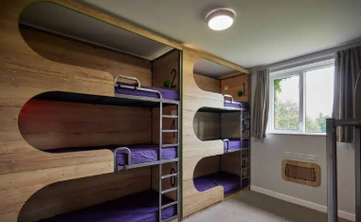
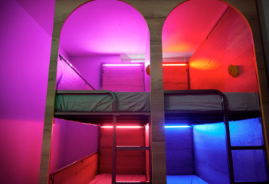
Sleeping
Absolutely – Bring something to read at night, a small game to play, a teddy – just remember that you are responsible for looking after it all.

Slide 7
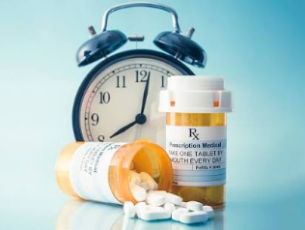
Medication
If your child has any prescribed medication. You will need to bring this to school on the afternoon of the trip. Fill in a form and handover.
Children will not be allowed to have medication in their bags

Slide 8

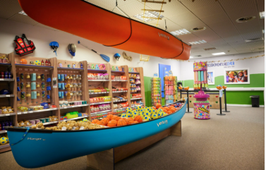
Please make sure your child does not take chewing gum – potential for mess on coach & in brand new centre.
Sweets – not needed for coach or centre – tuck shop will be available.
Souvenirs can also be purchased at the tuckshop – see price list.
If you would like your child to take money please ensure it is in a named wallet/purse/bag. No more than £10

Slide 9

Any Questions?
Welcome to stay back & speak to me in private / email office if you have any further questions or concerns.
Thanks for your time

